Slide 1
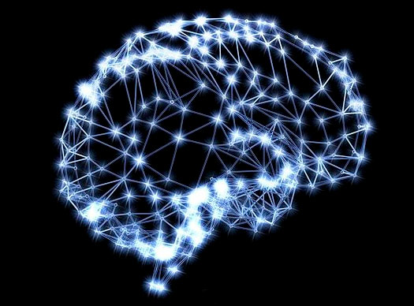
Sensors to Machines, Machines with Intelligence and New Life Paradigm
Neural Networks

Slide 2
ANN
Deep learning
What can we get from deep learning
Review
Outline
Artificial Neural network model (ANN)
Biological inspiration
Multiple Layer Perceptron (MLP)
Backpropagation Algorithm
Deep learning
What is deep neural network
Convolutional neural network (CNN)
Region based Convolutional neural network (R-CNN)
What can we get from deep learning?
Google AlphaGo
Notes:
神经网络
反向传播
深度学习

Slide 3
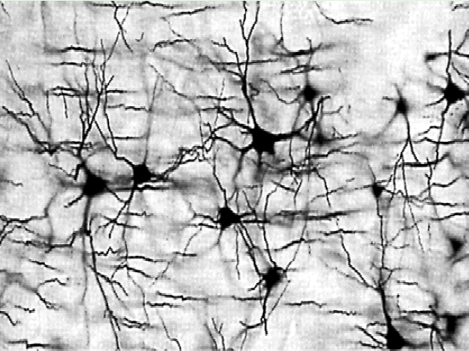
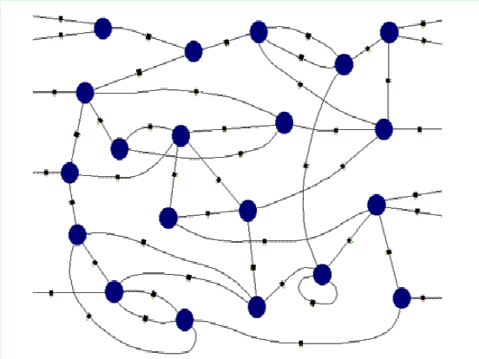
ANN
Deep learning
What can we get from deep learning
Review
Artificial Neural network model
Biological inspiration
Biological function
Biological structure
Notes:
7 chapters.

Slide 4
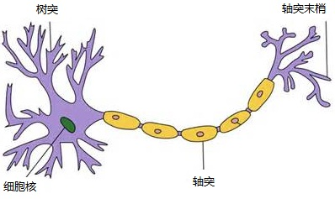
ANN
Deep learning
What can we get from deep learning
Review
Artificial Neural network model
Biological inspiration
dendrites
synapses
Nucleus
axon
The information transmission happens at the synapses.
Notes:
Synaptic weights 突触权值
Cumulative 求和
Stimulus 激发函数
All or none 是否激发

Slide 5
ANN
Deep learning
What can we get from deep learning
Review
Artificial Neural network model
Biological inspiration
dendrites
axon
synapses
The information transmission happens at the synapses.
Notes:
Synaptic weights 突触权值
Cumulative 求和
Stimulus 激发函数
All or none 是否激发

Slide 6
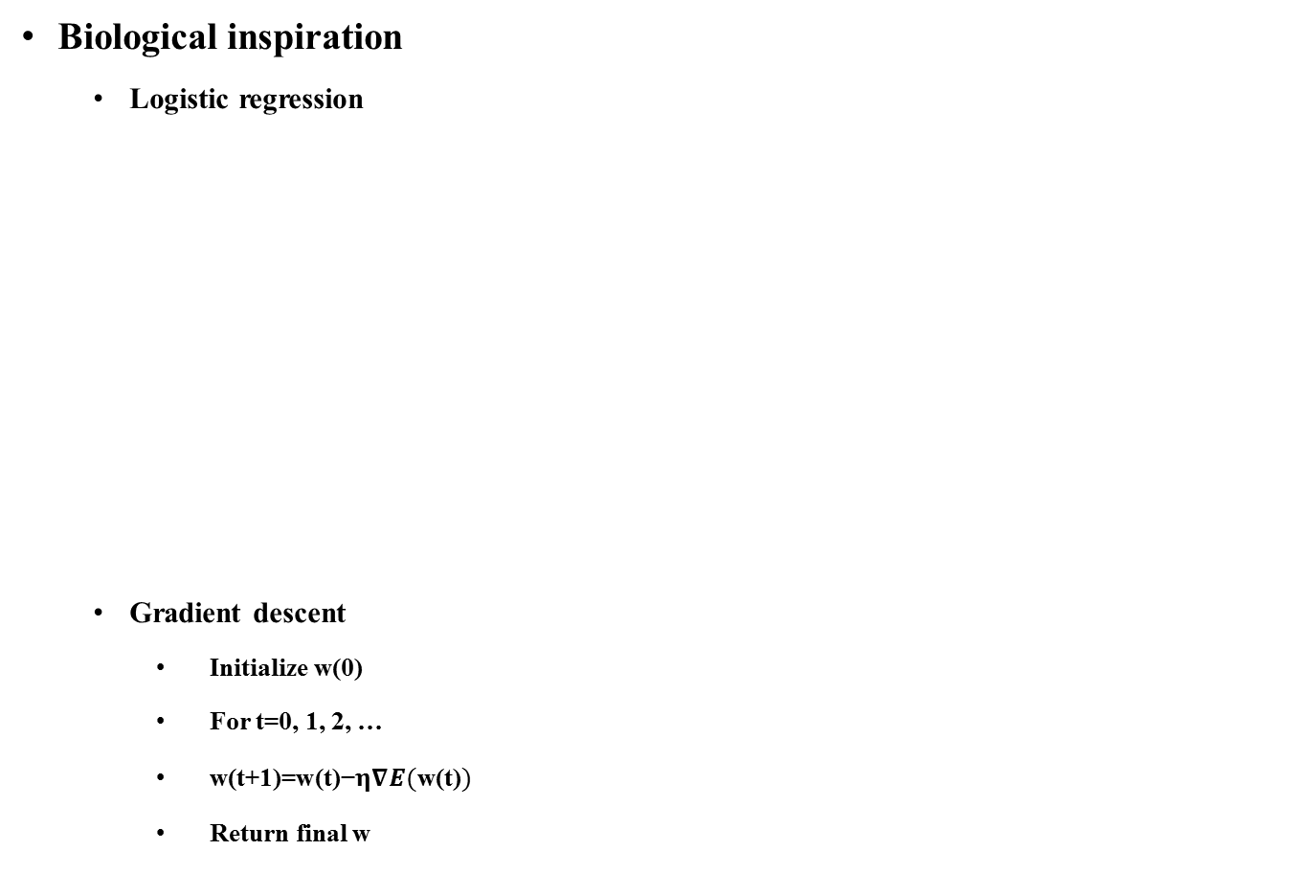
ANN
Deep learning
What can we get from deep learning
Review
Artificial Neural network model
Biological inspiration
Logistic regression
Gradient descent
Initialize w(0)
For t=0, 1, 2, …
$\text{w}\text{(}\text{t}\text{+1)=}\text{w}\text{(}\text{t}\text{)−}η∇E(\text{w}\text{(}\text{t}\text{)})$
Return final w
w₁
w₂
Inputs
Output
w₃
y
.
.
.
w_{n-1}
w_{n}
Notes:
7 chapters.

Slide 7
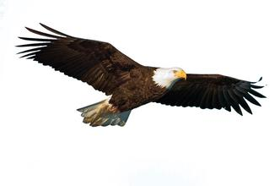

ANN
Deep learning
What can we get from deep learning
Review
Artificial Neural network model
Biological inspiration
Notes:
7 chapters.

Slide 8
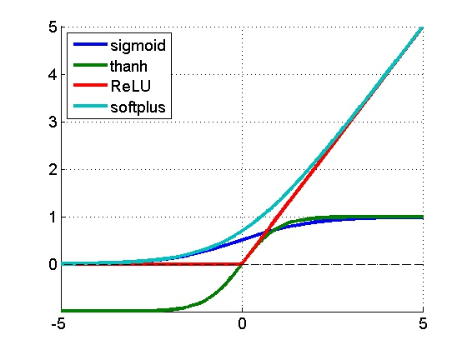
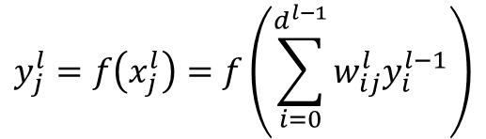
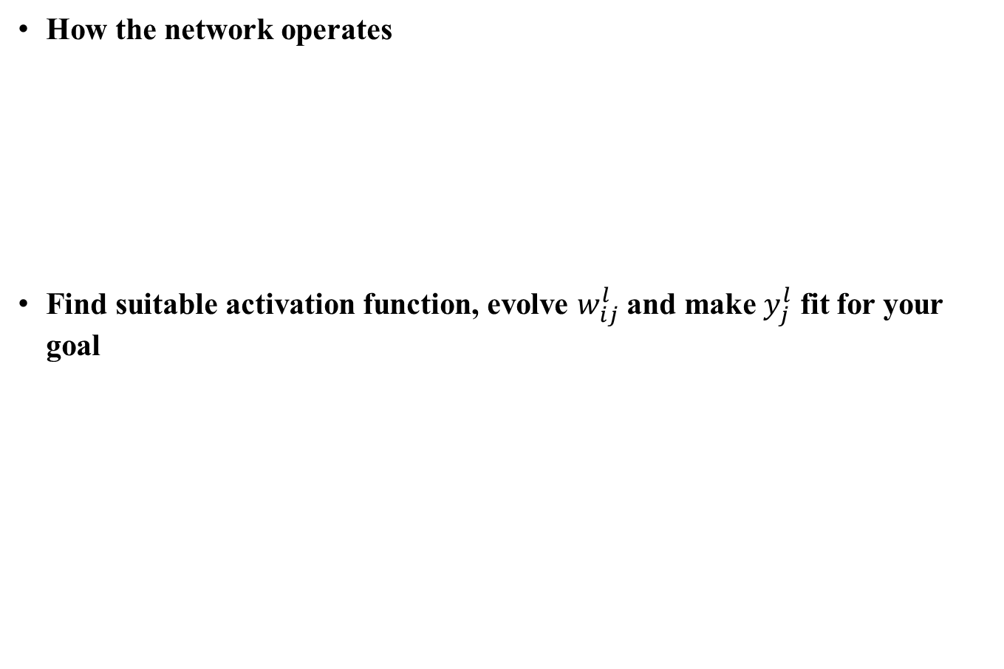
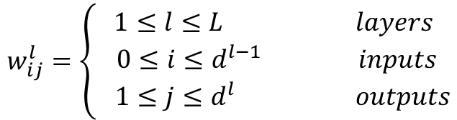
ANN
Deep learning
What can we get from deep learning
Review
Artificial Neural network model
How the network operates
Find suitable activation function, evolve $w_{ij}^{l}$ and make $y_{j}^{l}$ fit for your goal
$$w_{ij}^{l}=\left\{\begin{aligned}1≤l≤L layers \\ 0≤i≤d^{l−1} inputs \\ 1≤j≤d^{l} outputs\end{aligned}\right.$$
$$y_{j}^{l}=f\left(x_{j}^{l}\right)=f\left(\sum_{i=0}^{d^{l−1}}{w_{ij}^{l}y_{i}^{l−1}}\right)$$
Notes:
7 chapters.

Slide 9
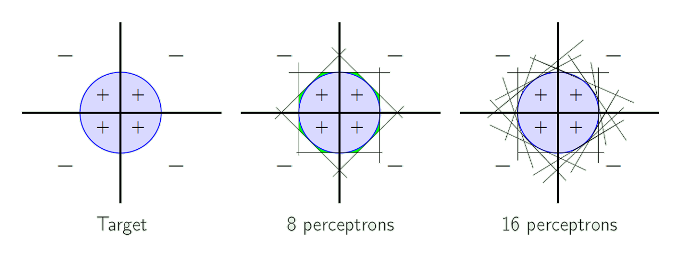
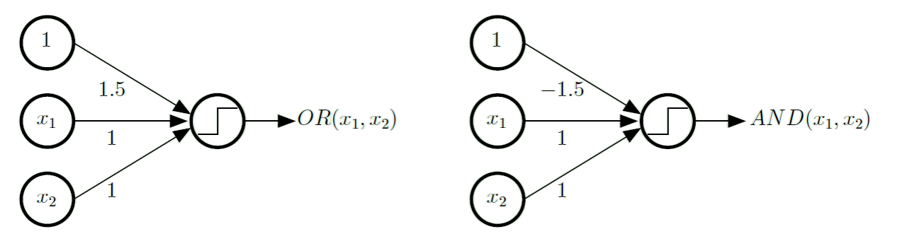
ANN
Deep learning
What can we get from deep learning
Review
Artificial Neural network model
A powerful model
Notes:
7 chapters.

Slide 10
ANN
Deep learning
What can we get from deep learning
Review
Artificial Neural network model
Multilayer perceptron (MLP)
Output layer
Hidden layer
Input layer
Notes:
7 chapters.

Slide 11
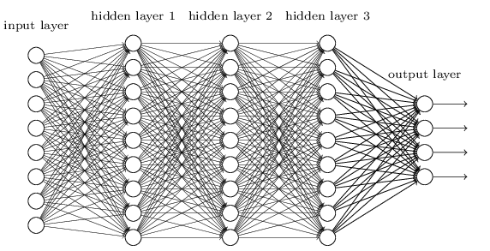
ANN
Deep learning
What can we get from deep learning
Review
Question
Question 1:
What happened if we increase the layers?
Notes:
多少层才合适？

Slide 12
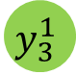

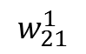
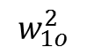

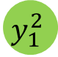
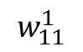
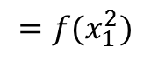
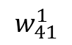

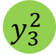
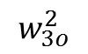
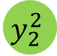
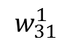
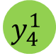
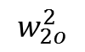
ANN
Deep learning
What can we get from deep learning
Review
Artificial Neural network model
Backpropagation algorithm
Forward
$$w_{11}^{1}$$
$$y_{1}^{1}$$
Inputs
$$w_{21}^{1}$$
$$y_{1}^{2}$$
$$w_{1o}^{2}$$
$$y_{2}^{1}$$
Output
$$w_{31}^{1}$$
$$w_{2o}^{2}$$
$$y_{2}^{2}$$
$$y_{out}$$
$$y_{3}^{1}$$
$$w_{41}^{1}$$
$$w_{3o}^{2}$$
$$y_{3}^{2}$$
$$y_{4}^{1}$$
$$y_{1}^{2}={f(y}_{1}^{1}×w_{11}^{1}+y_{2}^{1}×w_{21}^{1}+y_{3}^{1}×w_{31}^{1}+y_{4}^{1}×w_{41}^{1}+b_{1}^{2})$$
$$=f(x_{1}^{2})$$
$$y_{2}^{2}={f(y}_{1}^{1}×w_{12}^{1}+y_{2}^{1}×w_{22}^{1}+y_{3}^{1}×w_{32}^{1}+y_{4}^{1}×w_{42}^{1}+b_{2}^{2})$$
$$y_{out}^{}=f(y_{1}^{2}×w_{1o}^{2}+y_{1}^{2}×w_{1o}^{2}+y_{1}^{2}×w_{1o}^{2}$$
$y_{3}^{2}=f(y_{1}^{1}×w_{13}^{1}+y_{2}^{1}×w_{23}^{1}+y_{3}^{1}×w_{33}^{1}+y_{4}^{1}×w_{43}^{1}+b_{2}^{2}$)
Notes:
Y=f(x)

Slide 13
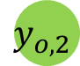
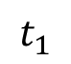
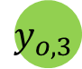

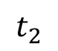
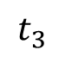
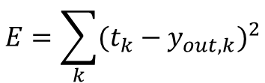
ANN
Deep learning
What can we get from deep learning
Review
Artificial Neural network model
Backpropagation algorithm
Backward
Error definition
Square error
Output
Target
$$y_{1}^{1}$$
Inputs
$$y_{1}^{2}$$
$$y_{o,1}$$
$$t_{1}$$
$$y_{2}^{1}$$
$$y_{2}^{2}$$
$$y_{o,2}$$
$$t_{2}$$
$$y_{3}^{1}$$
$$y_{3}^{2}$$
$$y_{o,3}$$
$$t_{3}$$
$$y_{4}^{1}$$
$$E=\sum_{k}{{(t_{k}−y_{out, k})}^{2}}$$
Notes:
Y=f(x)

Slide 14
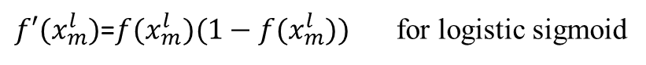
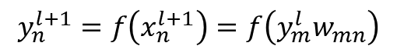
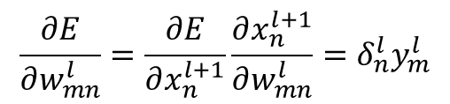
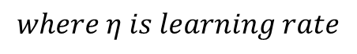
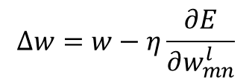
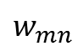
ANN
Deep learning
What can we get from deep learning
Review
Artificial Neural network model
Backpropagation algorithm
Chain rule
Weights updating
$$y_{n}^{l+1}=f\left(x_{n}^{l+1}\right)=f\left(y_{m}^{l}w_{mn}\right)$$
$$δ_{m}^{l}=\frac{∂E}{∂x_{m}^{l}}=\frac{∂E}{∂y_{m}^{l}}\frac{∂y_{m}^{l}}{∂x_{m}^{l}}=\frac{∂E}{∂y_{m}^{l}}f^{′}\left(x_{m}^{l}\right)=\frac{∂E}{∂x_{n}^{l+1}}\frac{∂x_{n}^{l+1}}{∂y_{m}^{l}}f^{′}\left(x_{m}^{l}\right)=\frac{∂E}{∂x_{n}^{l+1}}\frac{∂(w_{mn}y_{m}^{l})}{∂y_{m}^{l}}f^{′}\left(x_{m}^{l}\right)=δ_{n}^{l+1}w_{mn}f^{′}\left(x_{m}^{l}\right)$$
n
Layer l+1
$f′(x_{m}^{l})$=$f(x_{m}^{l})(1−f(x_{m}^{l}))$ for logistic sigmoid
$δ_{n}^{l}=\frac{∂E}{∂x_{n}^{l}}=\frac{∂E}{∂y_{n}^{l}}f^{′}\left(x_{n}^{l}\right)=2\left(y_{n}^{l}−t_{n}\right)f^{′}\left(x_{n}^{l}\right)$ for square error
Forward
Backward
$$w_{mn}$$
$$\frac{∂E}{∂w_{mn}^{l}}=\frac{∂E}{∂x_{n}^{l+1}}\frac{∂x_{n}^{l+1}}{∂w_{mn}^{l}}=δ_{n}^{l}y_{m}^{l}$$
m
Layer l
$$∆w=w−η\frac{∂E}{∂w_{mn}^{l}}$$
$$where η is learning rate$$
Notes:
Error definition 误差定义
dEdx=de

Slide 15
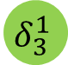
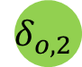
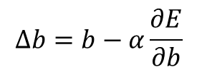
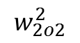

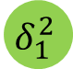
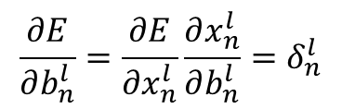
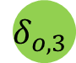
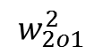
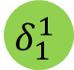
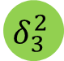
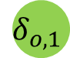
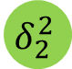


ANN
Deep learning
What can we get from deep learning
Review
Artificial Neural network model
Backpropagation algorithm
Weights updating
Output
Target
$${\text{δ}}_{1}^{1}$$
Inputs
$$δ_{1}^{2}$$
$$w_{2o1}^{2}$$
$$δ_{o,1}$$
$$t_{1}$$
$$δ_{2}^{1}$$
$$w_{2o2}^{2}$$
$$δ_{2}^{2}$$
$$δ_{o,2}$$
$$t_{2}$$
$$δ_{3}^{1}$$
$$w_{2o3}^{2}$$
$$δ_{3}^{2}$$
$$δ_{o,3}$$
$$t_{3}$$
$$δ_{4}^{1}$$
$$δ_{1}^{2}={f′(x}_{1}^{2})(δ_{o,1}w_{1o1}^{2}+δ_{o,2}w_{1o2}^{2}+δ_{o,3}w_{1o3}^{2})$$
$$\frac{∂E}{∂b_{n}^{l}}=\frac{∂E}{∂x_{n}^{l}}\frac{∂x_{n}^{l}}{∂b_{n}^{l}}=δ_{n}^{l}$$
$$δ_{2}^{2}={f′(x}_{2}^{2})(δ_{o,1}w_{2o1}^{2}+δ_{o,2}w_{2o2}^{2}+δ_{o,3}w_{2o3}^{2})$$
$$∆b=b−α\frac{∂E}{∂b}$$
$$δ_{3}^{2}={f′(x}_{3}^{2})(δ_{o,1}w_{3o1}^{2}+δ_{o,2}w_{3o2}^{2}+δ_{o,3}w_{3o3}^{2})$$
Notes:
Y=f(x)

Slide 16

ANN
Deep learning
What can we get from deep learning
Review
Artificial Neural network model
Backpropagation algorithm
Initialize all weights $w_{ij}^{l}$ at random
For t=0, 1, 2, … do
Pick $n∈\{1, 2, …, N\}$
Forward: Compute all $x_{j}^{l}$ and f($x_{j}^{l}$)
Backward: Compute all $δ_{j}^{l}$
Update the weights: $w_{ij}^{l}⟵w_{ij}^{l}−ηx_{j}^{l−1}δ_{j}^{l}$
Iterate to the next step until it is time to stop
Return the final weights $w_{ij}^{l}$
Notes:
7 chapters.

Slide 17

ANN
Deep learning
What can we get from deep learning
Review
Artificial Neural network model
What is wrong with backpropagation?
Local minimal
Error
Weights
Notes:
7 chapters.

Slide 18
ANN
Deep learning
What can we get from deep learning
Review
Outline
Artificial neural network
Biological inspiration
Logistic regression
Multiple Layer Perceptron (MLP)
Backpropagation algorithm
Deep learning
Deep neural network
Convolutional neural network (CNN)
Region based Convolutional neural network
Google AlphaGo
Notes:
神经网络
反向传播
深度学习

Slide 19

ANN
Deep learning
What can we get from deep learning
Review
Question
Question 1:
It would be able to represent abstract information
What happened if we increase the number of layers?
Notes:
7 chapters.

Slide 20

ANN
Deep learning
What can we get from deep learning
Review
Question
Question 2:
How can we make it to represent
Notes:
7 chapters.

Slide 21

ANN
Deep learning
What can we get from deep learning
Review
Deep learning
Why deep?
Notes:
7 chapters.

Slide 22


ANN
Deep learning
What can we get from deep learning
Review
Deep learning
What is deep neural network?
Deep in structure
Deep Belief Network (DBN)
Convolutional Neural Network (CNN)
(a) DBN
(b) CNN
G.E. Hinton and R.R. Salakhutdinov, Reducing the Dimensionality of Data with Neural Networks, Science, 28 July 2006, Vol. 313. no. 5786, pp. 504 - 507.
LeCun, Y., Bottou, L., Bengio, Y., and Haffner, P. (1998d). Gradient-based learning applied to document recognition. Proceedings of the IEEE, 86(11), 2278–2324.
Notes:
The training algorithm is shown here.

Slide 23


ANN
Deep learning
What can we get from deep learning
Review
Deep learning
What is deep?
Deep in time
Long short term memory (LSTM)
(a) Block/Cell structure
(b) Deep in Time axis
A. Graves, M. Liwicki, S. Fernandez, R. Bertolami, H. Bunke, J. Schmidhuber. A Novel Connectionist System for Improved Unconstrained Handwriting Recognition. IEEE Transactions on Pattern Analysis and Machine Intelligence, vol. 31, no. 5, 2009.
Notes:
7 chapters.

Slide 24

ANN
Deep learning
What can we get from deep learning
Review
Deep learning
What can we get from deep?
Extract the abstract information
H. Lee et al., “Convolutional deep belief networks for scalable unsupervised learning of hierarchical representation”, In Proceedings of the 26th International Conference on Machine Learning (ICML), 2009.
Notes:
7 chapters.

Slide 25

ANN
Deep learning
What can we get from deep learning
Review
Deep learning
Convolutional neural network (CNN)
Y. Bengio, P. Lamblin, D. Popovici and H. Larochelle, Greedy Layer-Wise Training of Deep Networks, in Advances in Neural Information Processing Systems 19 (NIPS‘06), pages 153-160, MIT Press 2007.
Notes:
7 chapters.

Slide 26


ANN
Deep learning
What can we get from deep learning
Review
Deep learning
Convolutional neural network (CNN)
Sparse Connectivity
Shared weights
Notes:
7 chapters.

Slide 27

ANN
Deep learning
What can we get from deep learning
Review
Deep learning
Convolutional neural network (CNN)
Sparse Connectivity
Notes:
7 chapters.

Slide 28

ANN
Deep learning
What can we get from deep learning
Review
Deep learning
Convolutional neural network (CNN)
Shared weights
Notes:
7 chapters.

Slide 29



















ANN
Deep learning
What can we get from deep learning
Review
Deep learning
Forward pass of CNN
Convolution
$2×2$ Kernel
$$w_{22}$$
$$w_{21}$$
Layer l
Layer l+1
$$w_{12}$$
$$w_{11}$$
$$y_{11}^{l}$$
$$y_{12}^{l}$$
$$y_{13}^{l}$$
$$y_{11}^{l+1}$$
$$y_{12}^{l+1}$$
$$y_{}^{l+1}=y_{}^{l}⋆ (w)$$
$$y_{21}^{l}$$
$$y_{22}^{l}$$
$$y_{23}^{l}$$
$$y_{21}^{l+1}$$
$$y_{22}^{l+1}$$
$$y_{31}^{l}$$
$$y_{32}^{l}$$
$$y_{33}^{l}$$
$$y_{11}^{l+1}=f\left(y_{11}^{l}×w_{22}+y_{12}^{l}×w_{21}+y_{21}^{l}×w_{12}+y_{22}^{l}×w_{11}+b\right)$$
$$y_{12}^{l+1}=f\left(y_{12}^{l}×w_{22}+y_{13}^{l}×w_{21}+y_{22}^{l}×w_{12}+y_{23}^{l}×w_{11}+b\right)$$
$$y_{21}^{l+1}=f\left(y_{21}^{l}×w_{22}+y_{22}^{l}×w_{21}+y_{31}^{l}×w_{12}+y_{32}^{l}×w_{11}+b\right)$$
$$y_{22}^{l+1}=f\left(y_{22}^{l}×w_{22}+y_{23}^{l}×w_{21}+y_{32}^{l}×w_{12}+y_{33}^{l}×w_{11}+b\right)$$
Notes:
7 chapters.

Slide 30












ANN
Deep learning
What can we get from deep learning
Review
Deep learning
Forward pass of CNN
Subsampling
Max pooling
Mean pooling
$$1$$
$$2$$
$$y_{out}^{}=max⁡(y_{1},y_{2},…,y_{n})$$
$$3$$
$$4$$
$$4$$
$$y_{out}^{}=avg⁡(y_{1},y_{2},…,y_{n})$$
$$1$$
$$2$$
$$3$$
$$4$$
$$2.5$$
Notes:
7 chapters.

Slide 31
ANN
Deep learning
What can we get from deep learning
Review
Deep learning
Convolutional neural network (CNN)
Y. Bengio, P. Lamblin, D. Popovici and H. Larochelle, Greedy Layer-Wise Training of Deep Networks, in Advances in Neural Information Processing Systems 19 (NIPS‘06), pages 153-160, MIT Press 2007.
Notes:
7 chapters.

Slide 32









ANN
Deep learning
What can we get from deep learning
Review
Deep learning
Backward pass of CNN
Subsampling
Max pooling
Mean pooling
$$0$$
$$0$$
$$δ_{i}=\left\{\begin{aligned}δ_{out} if y_{i}=y_{out}^{} \\ 0 otherwise\end{aligned}\right.$$
$$0$$
$$4$$
$$4$$
$$1$$
$$1$$
$$δ_{1}=δ_{2}=…{=δ}_{n}={\frac{1}{n}δ}_{out}$$
$$1$$
$$1$$
$$4$$
Notes:
7 chapters.

Slide 33


































ANN
Deep learning
What can we get from deep learning
Review
Deep learning
$$δ_{11}^{l}={(δ}_{11}^{l+1} ×w_{22})$$
Backward pass of CNN
Convolution
$$δ_{12}^{l}={(δ}_{11}^{l+1} ×w_{21}+δ_{12}^{l+1} ×w_{22})$$
$2×2$ Kernel
$$w_{22}$$
$$w_{21}$$
$$……$$
Layer l
Layer l+1
$$w_{12}$$
$$w_{11}$$
$$0$$
$$0$$
$$0$$
$$0$$
$$δ_{11}^{l}$$
$$δ_{12}^{l}$$
$$δ_{13}^{l}$$
$$δ_{}^{l}=δ_{}^{l+1}⋆rot180(w)$$
$$0$$
$$δ_{11}^{l+1}$$
$$δ_{12}^{l+1}$$
$$0$$
$$δ_{21}^{l}$$
$$δ_{22}^{l}$$
$$δ_{23}^{l}$$
$$0$$
$$δ_{21}^{l+1}$$
$$δ_{22}^{l+1}$$
$$0$$
$$δ_{31}^{l}$$
$$δ_{32}^{l}$$
$$δ_{33}^{l}$$
$$0$$
$$0$$
$$0$$
$$0$$
$$y_{11}^{l+1}=f\left(y_{11}^{l}×w_{22}+y_{12}^{l}×w_{21}+y_{21}^{l}×w_{12}+y_{22}^{l}×w_{11}+b\right)$$
$$y_{12}^{l+1}=f\left(y_{12}^{l}×w_{22}+y_{13}^{l}×w_{21}+y_{22}^{l}×w_{12}+y_{23}^{l}×w_{11}+b\right)$$
Forward
Pass
Forward
$$y_{21}^{l+1}=f\left(y_{21}^{l}×w_{22}+y_{22}^{l}×w_{21}+y_{31}^{l}×w_{12}+y_{32}^{l}×w_{11}+b\right)$$
Backward
$$y_{22}^{l+1}=f\left(y_{22}^{l}×w_{22}+y_{23}^{l}×w_{21}+y_{32}^{l}×w_{12}+y_{33}^{l}×w_{11}+b\right)$$
Notes:
7 chapters.

Slide 34




ANN
Deep learning
What can we get from deep learning
Review
Deep learning
$$\frac{∂E}{∂w_{mn}^{l}}=\frac{∂E}{∂x_{n}^{l+1}}\frac{∂x_{n}^{l+1}}{∂w_{mn}^{l}}=δ_{n}^{l+1}y_{m}^{l}$$
Backward pass of CNN
Convolution
Review
$2×2$ Kernel
$$∆w=w−η\frac{∂E}{∂w_{mn}^{l}}$$
$$w_{22}$$
$$w_{21}$$
Layer l
Layer l+1
$$\frac{∂E}{∂w_{11}}=δ_{11}^{l+1}y_{22}^{l}+δ_{12}^{l+1}y_{23}^{l}+δ_{21}^{l+1}y_{32}^{l}+δ_{22}^{l+1}y_{33}^{l}$$
$$w_{12}$$
$$w_{11}$$
$$δ_{11}^{l}$$
$$δ_{12}^{l}$$
$$δ_{13}^{l}$$
$$δ_{11}^{l+1}$$
$$δ_{12}^{l+1}$$
$$δ_{21}^{l}$$
$$δ_{22}^{l}$$
$$δ_{23}^{l}$$
$$……$$
$$δ_{21}^{l+1}$$
$$δ_{22}^{l+1}$$
$$δ_{31}^{l}$$
$$δ_{32}^{l}$$
$$δ_{33}^{l}$$
$$y_{11}^{l+1}=f\left(y_{11}^{l}×w_{22}+y_{12}^{l}×w_{21}+y_{21}^{l}×w_{12}+y_{22}^{l}×w_{11}+b\right)$$
Forward
Pass
$$y_{12}^{l+1}=f\left(y_{12}^{l}×w_{22}+y_{13}^{l}×w_{21}+y_{22}^{l}×w_{12}+y_{23}^{l}×w_{11}+b\right)$$
Forward
$$y_{21}^{l+1}=f\left(y_{21}^{l}×w_{22}+y_{22}^{l}×w_{21}+y_{31}^{l}×w_{12}+y_{32}^{l}×w_{11}+b\right)$$
Backward
$$y_{22}^{l+1}=f\left(y_{22}^{l}×w_{22}+y_{23}^{l}×w_{21}+y_{32}^{l}×w_{12}+y_{33}^{l}×w_{11}+b\right)$$
Notes:
7 chapters.

Slide 35



ANN
Deep learning
What can we get from deep learning
Review
Deep learning
$$\frac{∂E}{∂w_{mn}^{l}}=\frac{∂E}{∂x_{n}^{l+1}}\frac{∂x_{n}^{l+1}}{∂w_{mn}^{l}}=δ_{n}^{l+1}y_{m}^{l}$$
Backward pass of CNN
Convolution
Review
$2×2$ Kernel
$$∆w=w−η\frac{∂E}{∂w_{mn}^{l}}$$
$$w_{22}$$
$$w_{21}$$
Layer l
Layer l+1
$$\frac{∂E}{∂w_{11}}=δ_{11}^{l+1}y_{22}^{l}+δ_{12}^{l+1}y_{23}^{l}+δ_{21}^{l+1}y_{32}^{l}+δ_{22}^{l+1}y_{33}^{l}$$
$$w_{12}$$
$$w_{11}$$
$$δ_{11}^{l}$$
$$δ_{12}^{l}$$
$$δ_{13}^{l}$$
$$δ_{11}^{l+1}$$
$$δ_{12}^{l+1}$$
$$\frac{∂E}{∂w_{12}}=δ_{11}^{l+1}y_{21}^{l}+δ_{12}^{l+1}y_{22}^{l}+δ_{21}^{l+1}y_{31}^{l}+δ_{22}^{l+1}y_{32}^{l}$$
$$δ_{21}^{l}$$
$$δ_{22}^{l}$$
$$δ_{23}^{l}$$
$$δ_{21}^{l+1}$$
$$δ_{22}^{l+1}$$
$$δ_{31}^{l}$$
$$δ_{32}^{l}$$
$$δ_{33}^{l}$$
$$……$$
$$y_{11}^{l+1}=f\left(y_{11}^{l}×w_{22}+y_{12}^{l}×w_{21}+y_{21}^{l}×w_{12}+y_{22}^{l}×w_{11}+b\right)$$
$$\frac{∂E}{∂w}=y^{l}⋆rot180(δ^{l+1})$$
Forward
Pass
$$y_{12}^{l+1}=f\left(y_{12}^{l}×w_{22}+y_{13}^{l}×w_{21}+y_{22}^{l}×w_{12}+y_{23}^{l}×w_{11}+b\right)$$
Forward
$$y_{21}^{l+1}=f\left(y_{21}^{l}×w_{22}+y_{22}^{l}×w_{21}+y_{31}^{l}×w_{12}+y_{32}^{l}×w_{11}+b\right)$$
Backward
$$y_{22}^{l+1}=f\left(y_{22}^{l}×w_{22}+y_{23}^{l}×w_{21}+y_{32}^{l}×w_{12}+y_{33}^{l}×w_{11}+b\right)$$
Notes:
7 chapters.

Slide 36


ANN
Deep learning
What can we get from deep learning
Review
Deep learning
Backward pass of CNN
Convolution
$2×2$ Kernel
$$\frac{∂E}{∂b}=\frac{∂E}{∂x_{}^{l+1}}\frac{∂x_{}^{l+1}}{∂b}=\sum_{u,v}{δ_{uv}^{l+1}}$$
$$w_{22}$$
$$w_{21}$$
Layer l
Layer l+1
$$w_{12}$$
$$w_{11}$$
$$∆b=b−η\frac{∂E}{∂b}$$
$$δ_{11}^{l}$$
$$δ_{12}^{l}$$
$$δ_{13}^{l}$$
$$δ_{11}^{l+1}$$
$$δ_{12}^{l+1}$$
$$δ_{21}^{l}$$
$$δ_{22}^{l}$$
$$δ_{23}^{l}$$
$$δ_{21}^{l+1}$$
$$δ_{22}^{l+1}$$
$$δ_{31}^{l}$$
$$δ_{32}^{l}$$
$$δ_{33}^{l}$$
$$y_{11}^{l+1}=f\left(y_{11}^{l}×w_{22}+y_{12}^{l}×w_{21}+y_{21}^{l}×w_{12}+y_{22}^{l}×w_{11}+b\right)$$
Forward
Pass
$$y_{12}^{l+1}=f\left(y_{12}^{l}×w_{22}+y_{13}^{l}×w_{21}+y_{22}^{l}×w_{12}+y_{23}^{l}×w_{11}+b\right)$$
Forward
$$y_{21}^{l+1}=f\left(y_{21}^{l}×w_{22}+y_{22}^{l}×w_{21}+y_{31}^{l}×w_{12}+y_{32}^{l}×w_{11}+b\right)$$
Backward
$$y_{22}^{l+1}=f\left(y_{22}^{l}×w_{22}+y_{23}^{l}×w_{21}+y_{32}^{l}×w_{12}+y_{33}^{l}×w_{11}+b\right)$$
Notes:
7 chapters.

Slide 37

ANN
Deep learning
What can we get from deep learning
Review
Deep learning
ImageNet Classification with Deep Convolutional Neural Networks (Alex net)
A. Krizhevsky, I. Sutskever, and G. Hinton. ImageNet classification with deep convolutional neural networks. In NIPS, 2012.
Notes:
7 chapters.

Slide 38

ANN
Deep learning
What can we get from deep learning
Review
Deep learning
Region with CNN feature (R-CNN)
Region proposals
selective search
J. Uijlings, K. van de Sande, T. Gevers, and A. Smeulders. Selective search for object recognition. IJCV, 2013.
Notes:
7 chapters.

Slide 39

ANN
Deep learning
What can we get from deep learning
Review
Deep learning
Region with CNN feature (R-CNN)
Region proposals
selective search
Feature extraction
Warped region
supervised pre-training
R. Girshick, J. Donahue, T. Darrell, and J. Malik. Rich feature hierarchies for accurate object detection and semantic segmentation. In CVPR, 2014.
Notes:
7 chapters.

Slide 40
ANN
Deep learning
What can we get from deep learning
Review
Deep learning
Region with CNN feature (R-CNN)
Region proposals
Selective search
Feature extraction
Warped region
Training
Supervised Pre-training
Fine-tuning
Object category classifiers
Extension
Fast R-CNN
Faster R-CNN
R. Girshick, Fast R-CNN. Computer Vision and Pattern recognition
S. ReN, K. He, R. Girshick, J. Sun Faster R-CNN: Towards Real-Time Object Detection with Region Proposal Networks Computer Vision and Pattern recognition
Notes:
7 chapters.

Slide 41
ANN
Deep learning
What can we get from deep learning
Review
Outline
Neural network model
Biological inspiration
Logistic Regression
Multiple Layer Perceptron (MLP)
Backpropagation Algorithm
Deep learning
What is deep neural network
Convolutional neural network
Region based Convolutional neural network
What can we get from deep learning
Google AlphaGo
Notes:
神经网络
反向传播
深度学习

Slide 42


ANN
Deep learning
What can we get from deep learning
Review
What can we get from deep?
Text generation
A. Graves, “Generating Sequences With Recurrent Neural Networks ”, Neural and Evolutionary Computing, 2013
Notes:
7 chapters.

Slide 43

ANN
Deep learning
What can we get from deep learning
Review
What can we get from deep?
Dimension reduction
G.E. Hinton and R.R. Salakhutdinov, Reducing the Dimensionality of Data with Neural Networks, Science, 28 July 2006, Vol. 313. no. 5786, pp. 504 - 507.
Notes:
7 chapters.

Slide 44


ANN
Deep learning
What can we get from deep learning
Review
What can we get from deep?
Dimension reduction
PCA
Deep autoencoder
G.E. Hinton and R.R. Salakhutdinov, Reducing the Dimensionality of Data with Neural Networks, Science, 28 July 2006, Vol. 313. no. 5786, pp. 504 - 507.
Notes:
7 chapters.

Slide 45

ANN
Deep learning
What can we get from deep learning
Review
What can we get from deep?
Deep learning won most of machine learning challenges!
- Object recognition (Simonyan et al., 2015)
- Natural machine translation (Bahdanau et al., 2014)
- Speech recognition (Chorowski et al., 2014)
- Face recognition (Taigman et al., 2014)
- Emotion recognition (Ebrahimi-Kahou et al., 2014)
- Human pose estimation (Jain et al., 2014)
- Deep reinforcement learning(mnih et al., 2013)
- Image/Video caption (Xu et al., 2015)
Notes:
7 chapters.

Slide 46

ANN
Deep learning
What can we get from deep learning
Review
Google AlphaGo
AlphaGo

Slide 47

ANN
Deep learning
What can we get from deep learning
Review
Google AlphaGo
Traditional AI for chess: Minimax

Slide 48


ANN
Deep learning
What can we get from deep learning
Review
Google AlphaGo
Difficulty of Go
19$×$19=361

Slide 49










ANN
Deep learning
What can we get from deep learning
Review
Google AlphaGo
Difficulty of Go
Possibility
Method 1
Method 2
$$(Process)$$
$$361×360×359×…$$
$$≈{10}^{761}$$
$$(Results)$$
$$Black+White+Blank=3$$
$$3^{361}$$
$$≈{10}^{172}$$
$$Elementary particles of our universe$$
$$≈{10}^{80}$$

Slide 50

ANN
Deep learning
What can we get from deep learning
Review
Google AlphaGo
How does AlphaGo work?
Fast Rollout network
Policy network
Value network
Monte Carlo Tree
Neural network training pipeline and architecture
D Silver et al. Nature 529, 484–489 (2016) doi:10.1038/nature16961

Slide 51

ANN
Deep learning
What can we get from deep learning
Review
Google AlphaGo
How does AlphaGo work?
Fast Rollout network
Linear softmax
D Silver et al. Mastering the game of Go with deep neural networks and tree search Nature 529, 484–489 (2016) doi:10.1038/nature16961

Slide 52

ANN
Deep learning
What can we get from deep learning
Review
Google AlphaGo
How does AlphaGo work?
Fast Rollout network
Policy network
D Silver et al. Mastering the game of Go with deep neural networks and tree search Nature 529, 484–489 (2016) doi:10.1038/nature16961

Slide 53
ANN
Deep learning
What can we get from deep learning
Review
Google AlphaGo
How does AlphaGo work?
Fast Rollout network
Policy network
Value network
D Silver et al. Mastering the game of Go with deep neural networks and tree search Nature 529, 484–489 (2016) doi:10.1038/nature16961

Slide 54

ANN
Deep learning
What can we get from deep learning
Review
Google AlphaGo
How does AlphaGo work?
Fast Rollout network
Policy network
Value network
Monte Carlo Tree
Monte Carlo tree search in AlphaGo
D Silver et al. Mastering the game of Go with deep neural networks and tree search Nature 529, 484–489 (2016) doi:10.1038/nature16961

Slide 55


ANN
Deep learning
What can we get from deep learning
Review
Google AlphaGo
How does AlphaGo learn?
Reinforce Learning
In simple terms:
Dog Training
Reward

Slide 56

ANN
Deep learning
What can we get from deep learning
Review
Google AlphaGo
How does AlphaGo perform?

Slide 57

ANN
Deep learning
What can we get from deep learning
Review
Google AlphaGo
How Far Can Artificial Intelligence Go?

Slide 58


ANN
Deep learning
What can we get from deep learning
Review
Google AlphaGo
How Far Can Artificial Intelligence Go?

Slide 59
ANN
Deep learning
What can we get from deep learning
Review
Review
Neural network model
Biological inspiration
Logistic regression
Multiple Layer Perceptron (MLP)
Forward
Backward
Backpropagation Algorithm
Chain rule
Weights updating
Notes:
神经网络
反向传播
深度学习

Slide 60
ANN
Deep learning
What can we get from deep learning
Review
Review
Deep learning
Deep neural network
Structure
Deep Belief Network
Convolutional neural network
Function
Static
Dynamic
Convolutional neural network (CNN)
Convolution layer
Subsampling layer
Region based Convolutional neural network
Notes:
神经网络
反向传播
深度学习

Slide 61
ANN
Deep learning
What can we get from deep learning
Review
Homework
Homework
Explain why an MLP does not learn if the initial weights and biases are all zeros.
Notes:
7 chapters.

Slide 62
Thank you!

